Slide 1
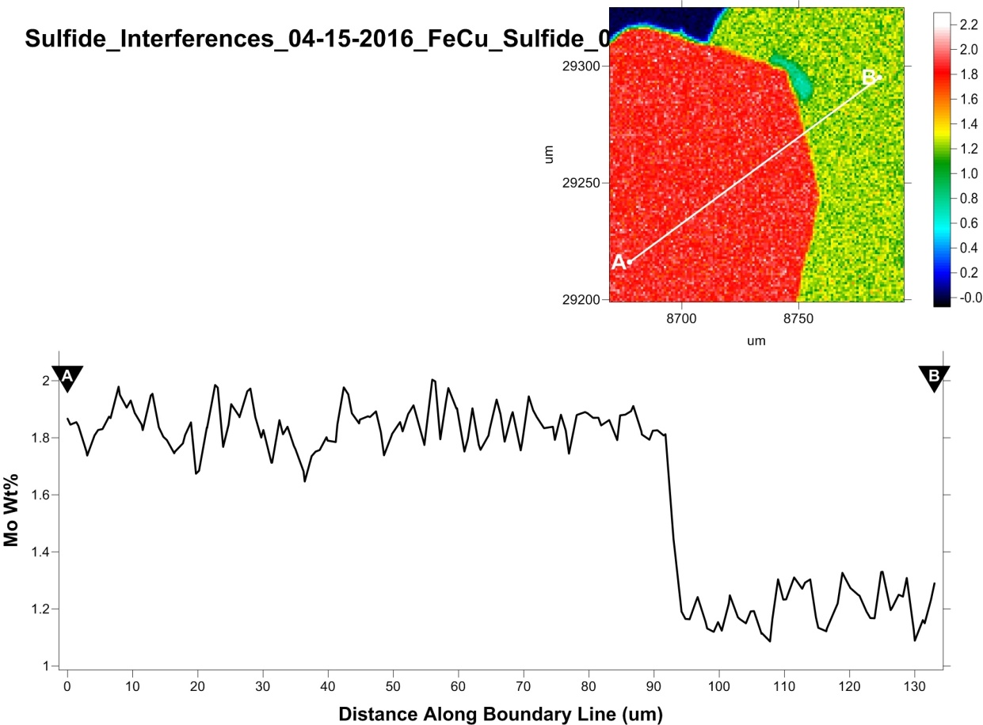
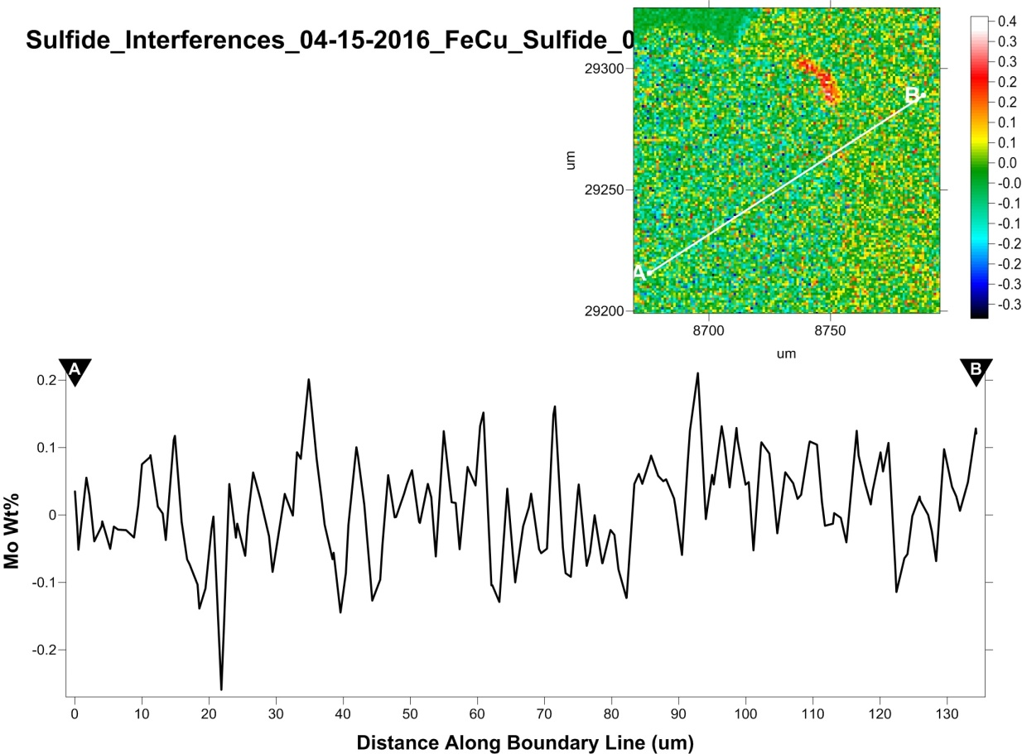
How to evaluate/treat and random/systematic errors in EPMA
John J. Donovan, CAMCOR, University of Oregon

Slide 2
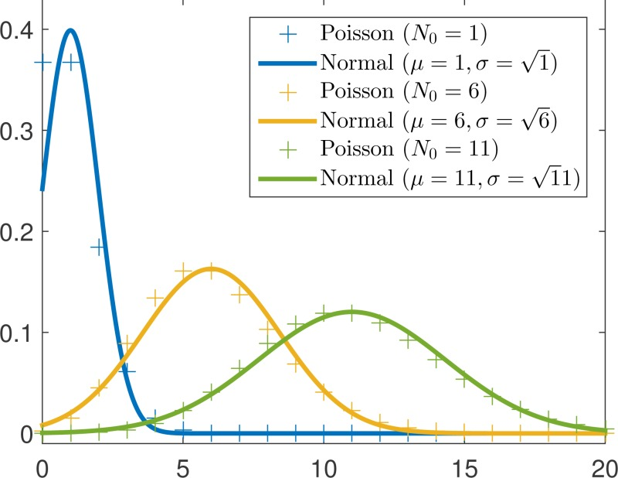
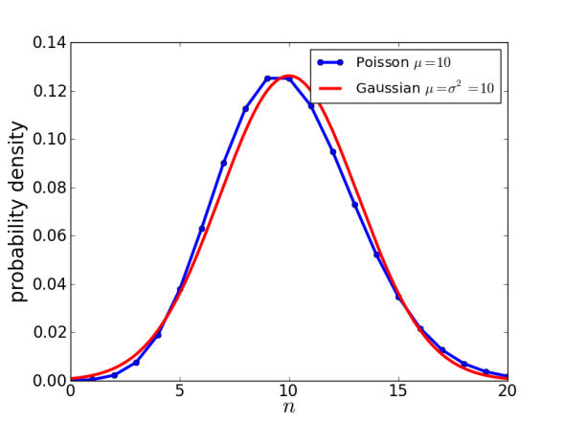
Our random errors are described by simple photon counting statistics
Since we cannot count less than zero photons, these statistics are best described by Poisson statistics…
However, these calculations involve an exponential and a factorial which are cumbersome to handle, so we therefore choose to describe our photon counting statistics using Gaussian (also known as normal) statistics…
Which is described by simply taking the square root of the raw count variance…
Standard deviation = $\sqrt{sigma}$

Slide 3
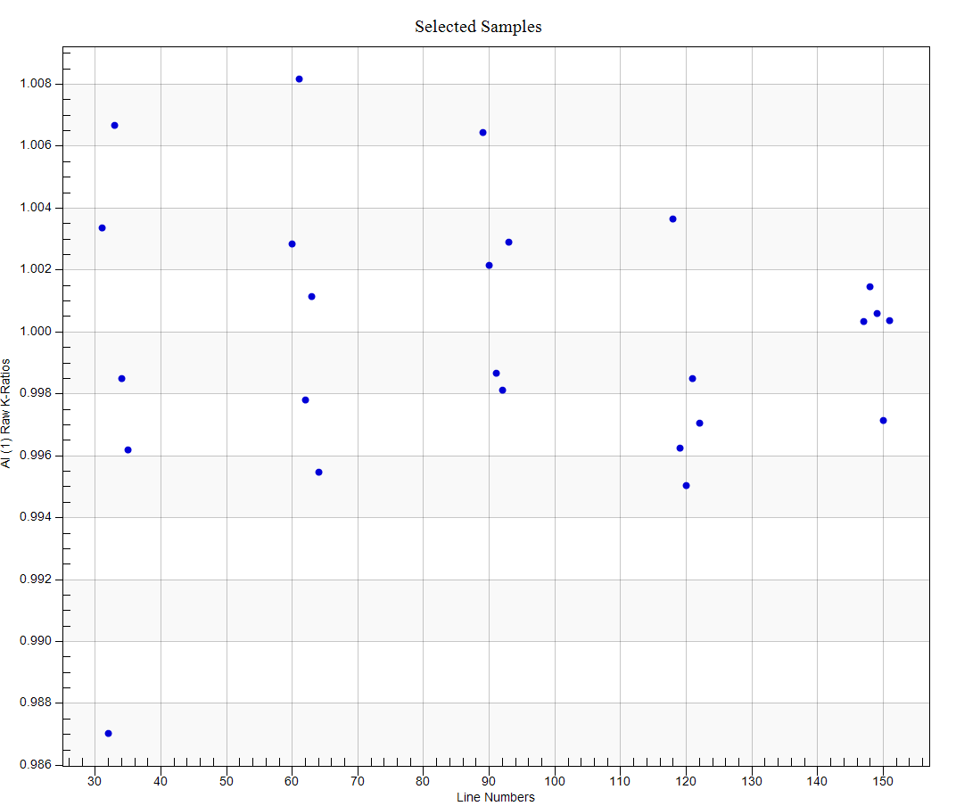
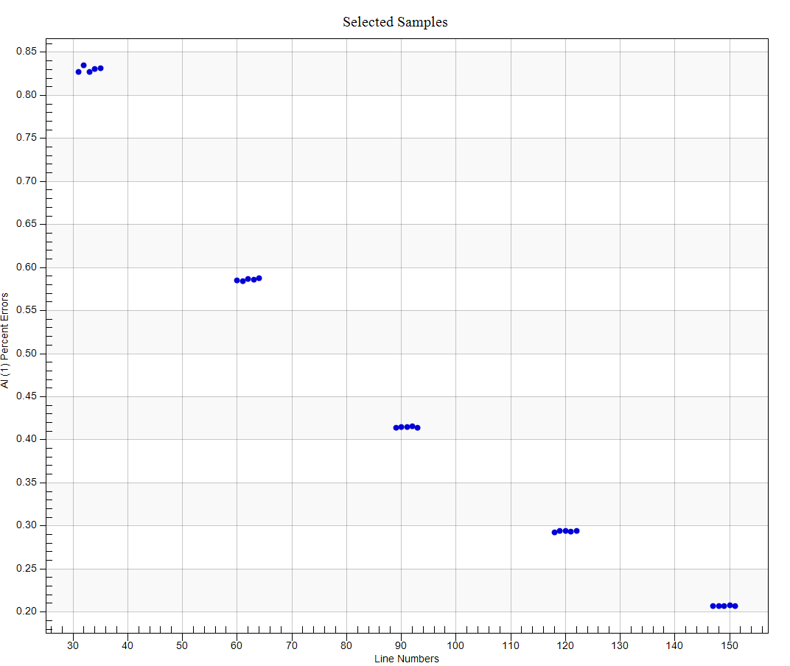
Errors in precision or sensitivity can always be improved by:
averaging more measurements
or counting longer!
Sensitivity vs. acquisition #
2x time
SQRT sensitivity
2x
sensitivity
K-ratio vs. acquisition #
4x time

Slide 4
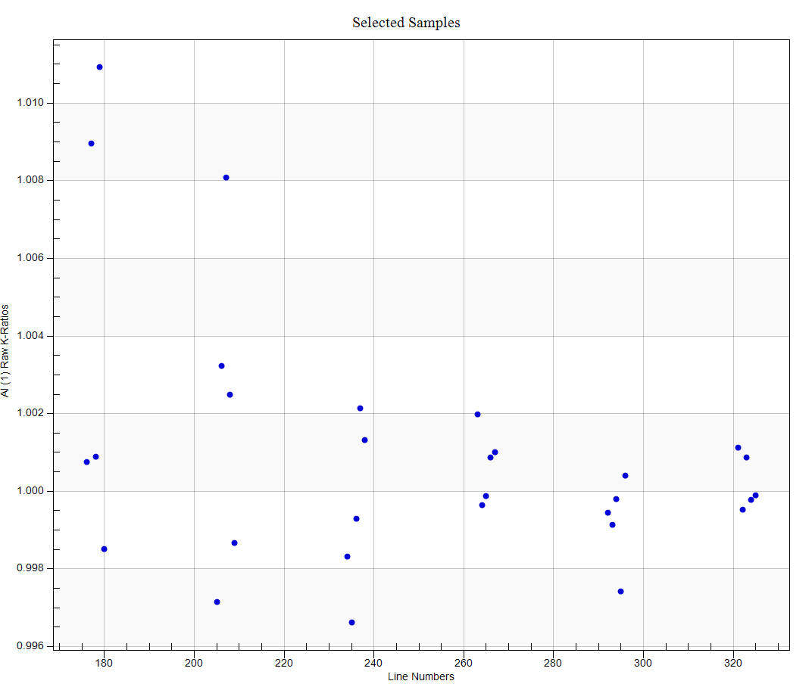
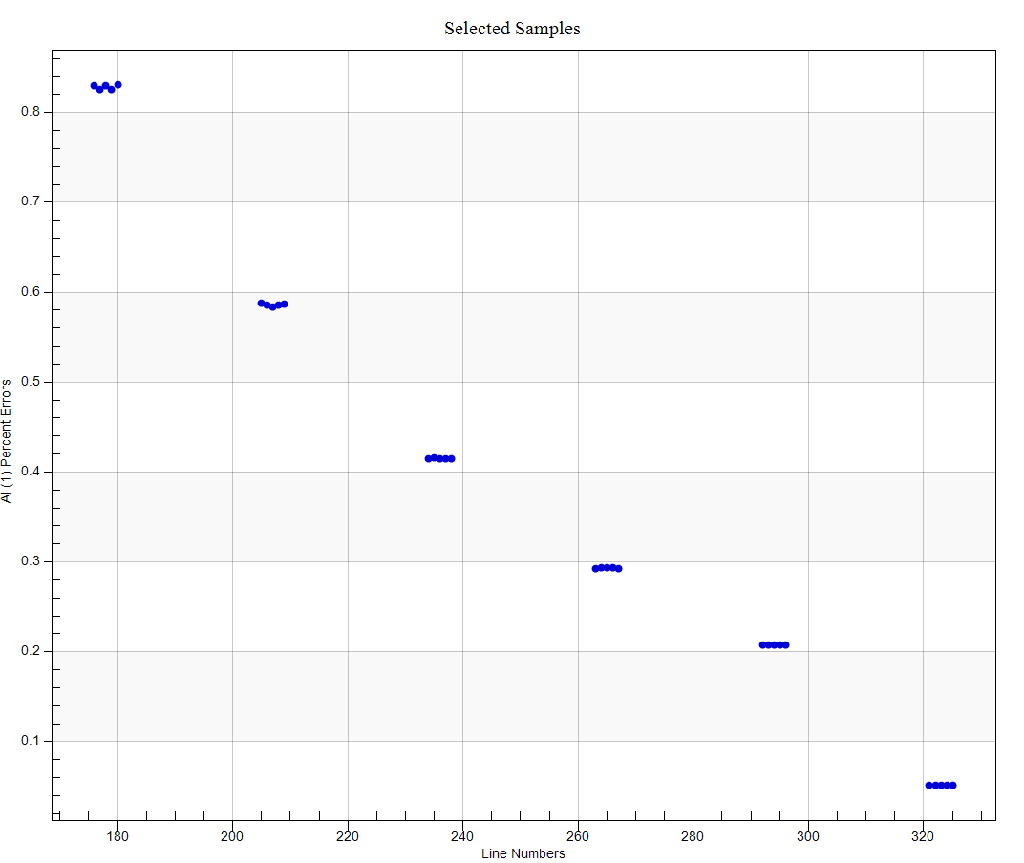
We see the same trends by increasing beam currents:
Sensitivity vs. acquisition #
K-ratio vs. acquisition #

Slide 5
The “takeaway” from all this?
Double your counting time
and double your beam current
to double your sensitivity!

Slide 6
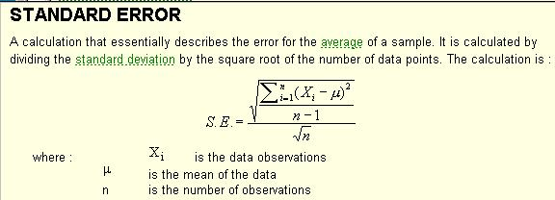
We should use std dev for single data points, std err for averages

Slide 7
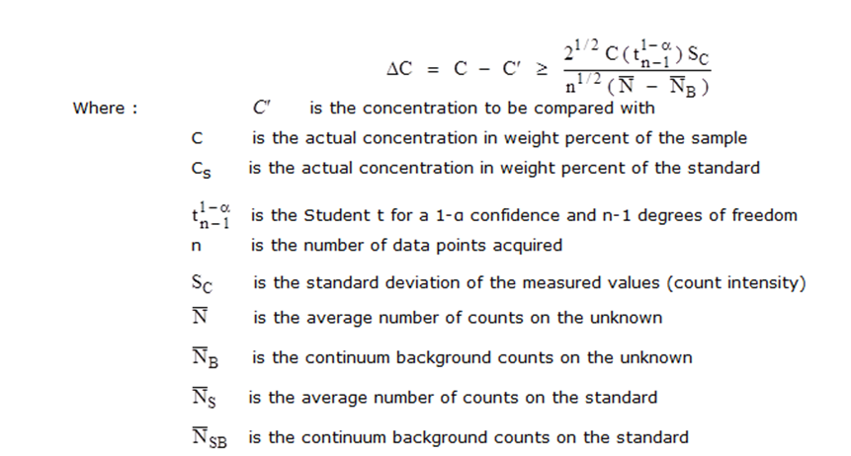
Exception for t-test: use Std Deviation!

Slide 8
Systematic (accuracy) errors
incorrect values for composition of standards
instrumental instability (temperature effect on crystal 2d, stage Z drift as it heats up)
inappropriate matrix corrections, “unanalyzed” (missing or excess) elements
poor electrical ground of standard and/or unknown
carbon coat variation (2 effects- one for soft x-ray, another for hard x-rays)
beam change/damage to unknown (e.g. TDI effects for Na, K in glass)
difference in peak shape/position for light elements (standard vs unknown)
on-peak or background (off-peak) spectral interferences
pulse height depression on standards, pulse height gain on traces, dead time calibrations
fluorescence across observed phase boundaries (e.g. diffusion couple)
inaccurate calibration of accelerating voltage (use Duane-Hunt limit)

Slide 9
Primary standard (multiplicative)
Dominant effects:
Standard
Matrix
Deadtime
Intensity
Dominant effects:
Background
Interferences
Background (subtraction)
0
0
Concentration
100

Slide 10
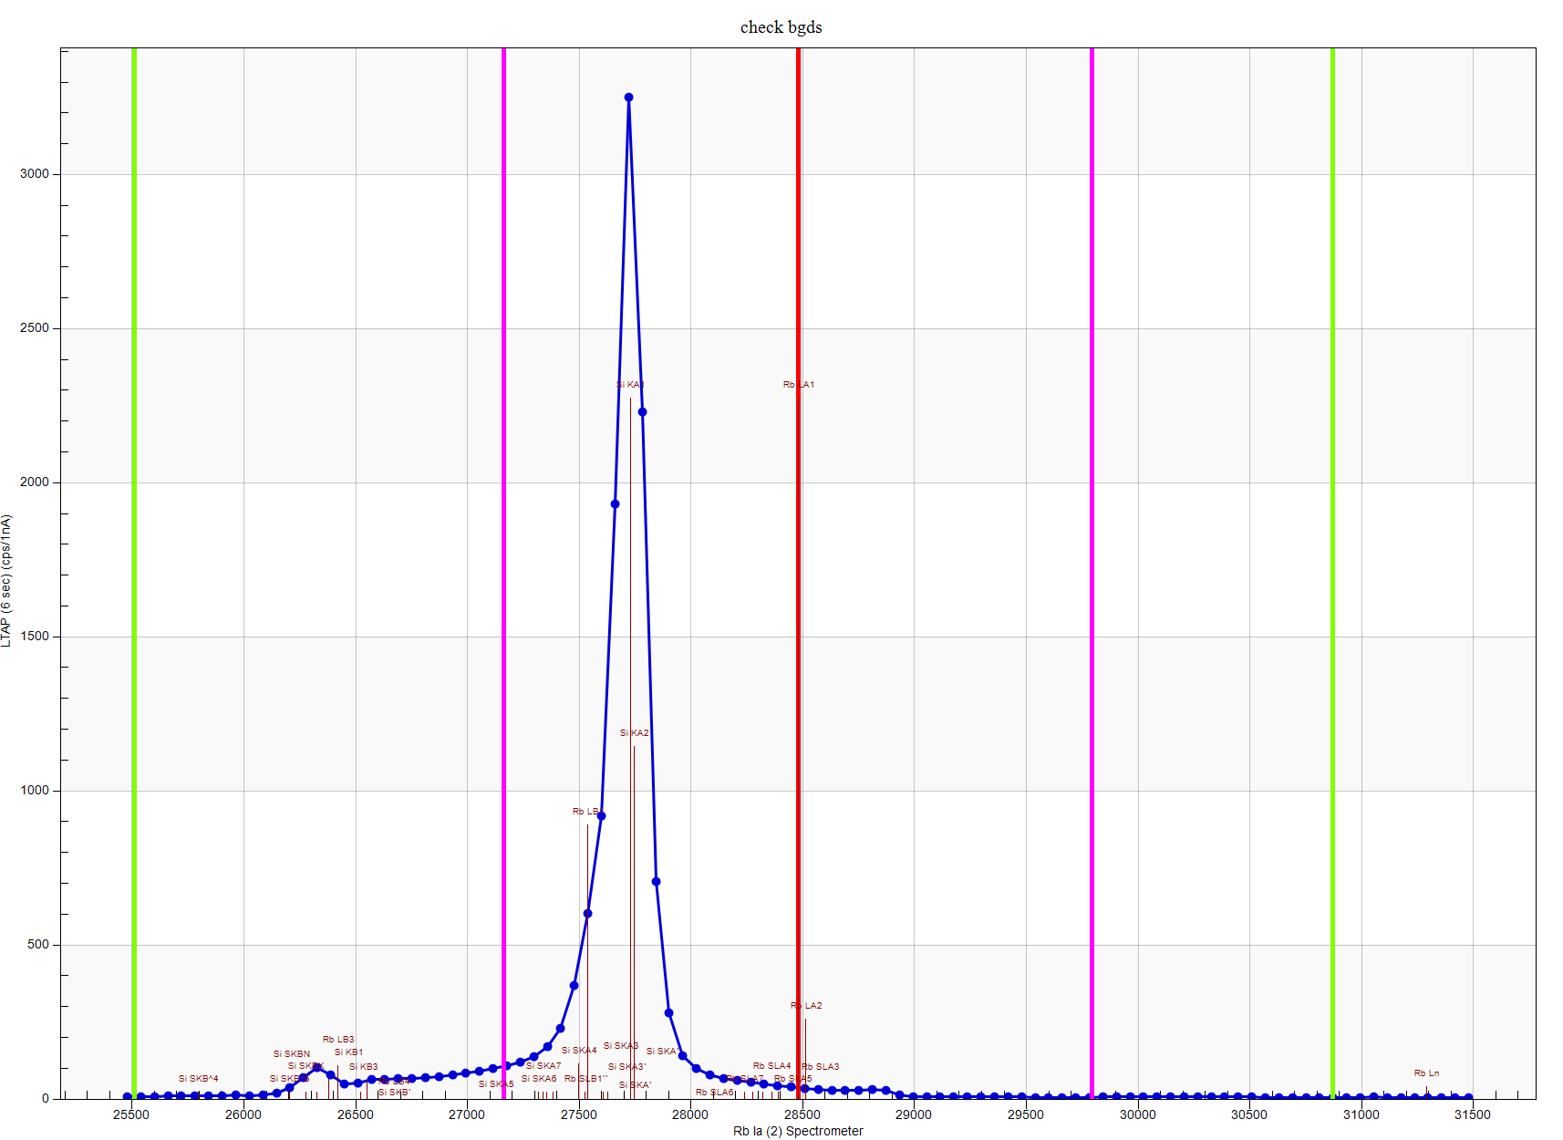
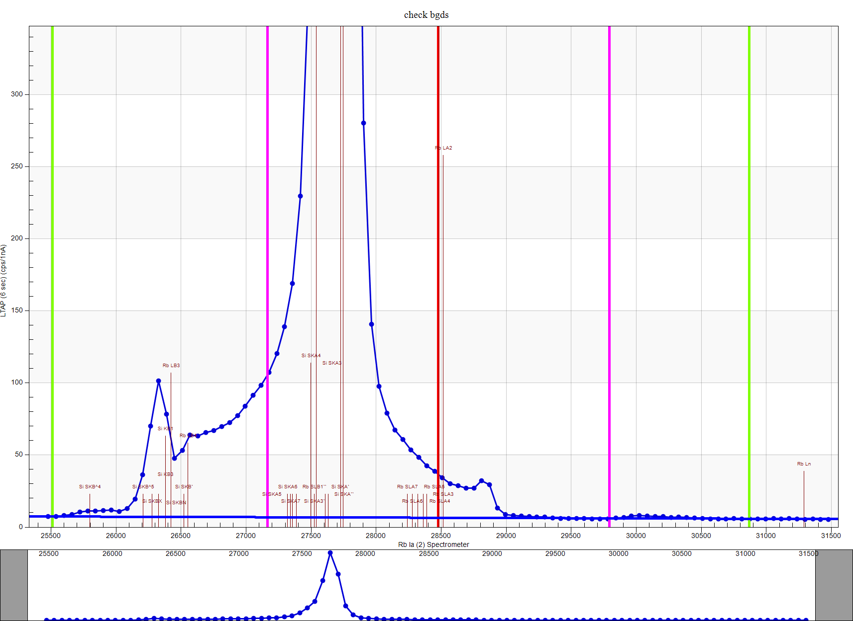
Spectral Interference Corrections

Slide 11
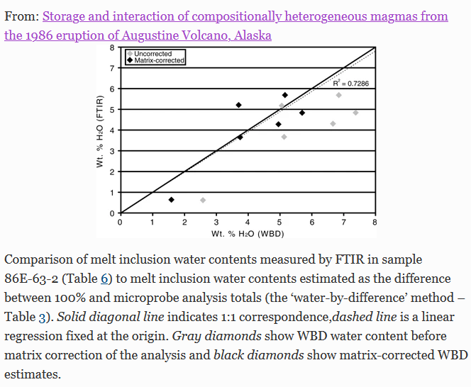
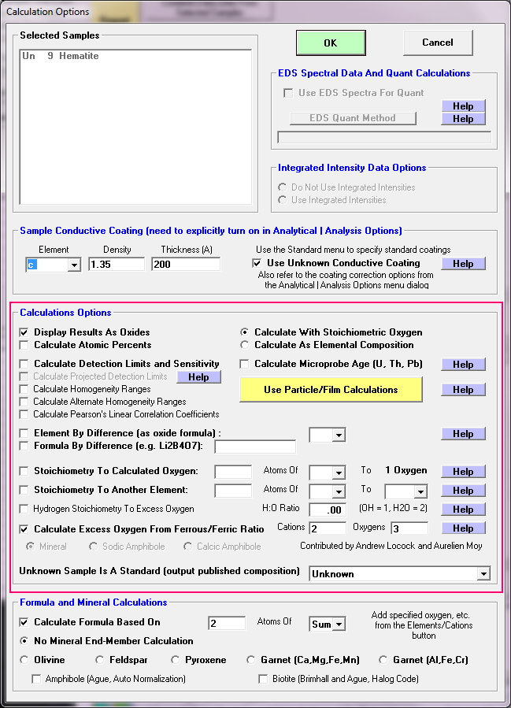
Errors due to “unanalyzed” elements!
Examples:
Excess oxygen when ferric iron is present
When water or hydroxyl are present in minerals and glasses
Carbon in carbonates
Boron, lithium, etc.
Roman et al., 2006
Fournelle et al., 2020

Slide 12
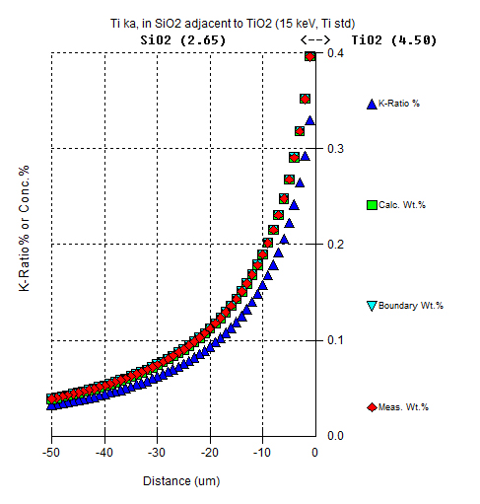
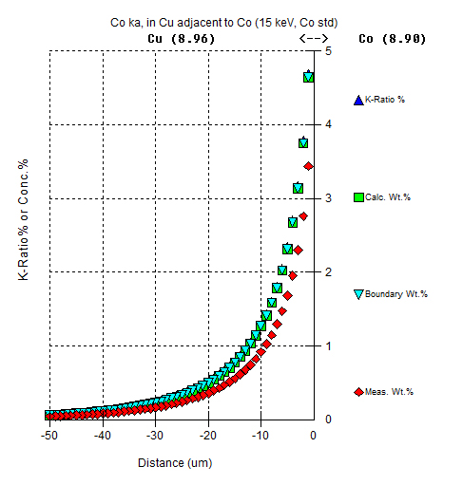
“Trace” Ti in quartz adjacent to rutile (not chemical diffusion!)
Borisova et al., Secondary Fluorescence effects in microbeam analysis, Chemical Geology, 490, 22-29, (2018)
“Trace” Co in copper adjacent to
cobalt (not chemical diffusion!)

Slide 13
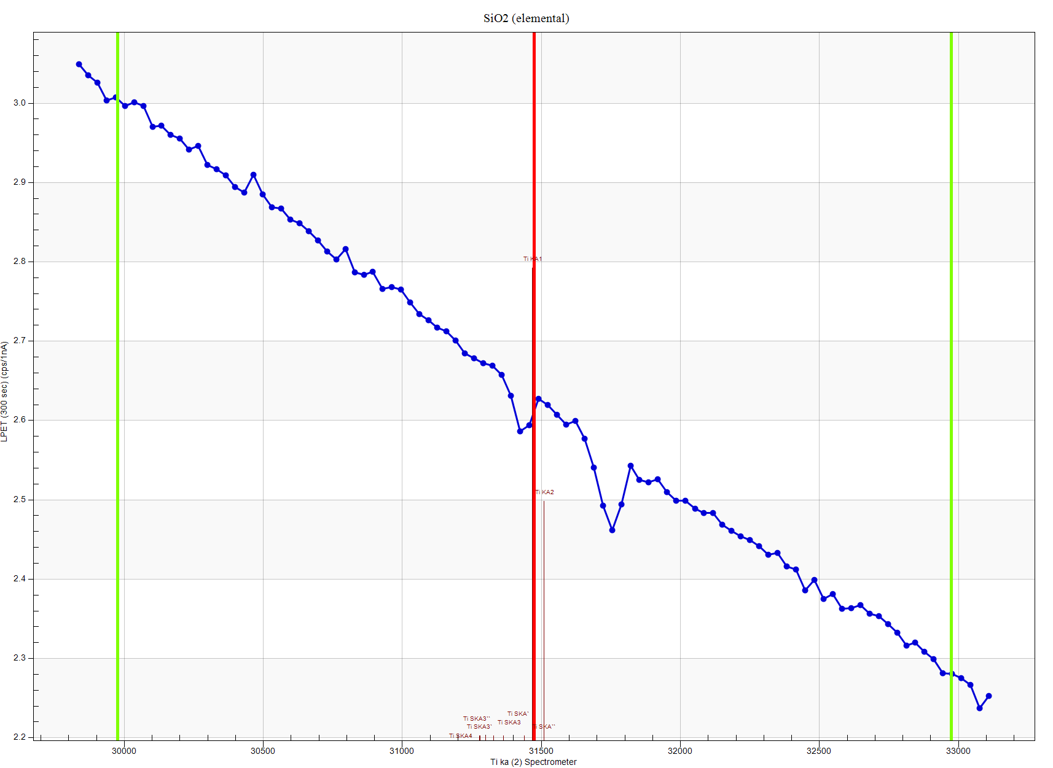
Accuracy Check!
Trace Accuracy: How accurately can you measure zero?
Ti ka in Quartz
“Holes” in the
continuum!
Requires a “blank” correction for high accuracy traces!

Slide 14
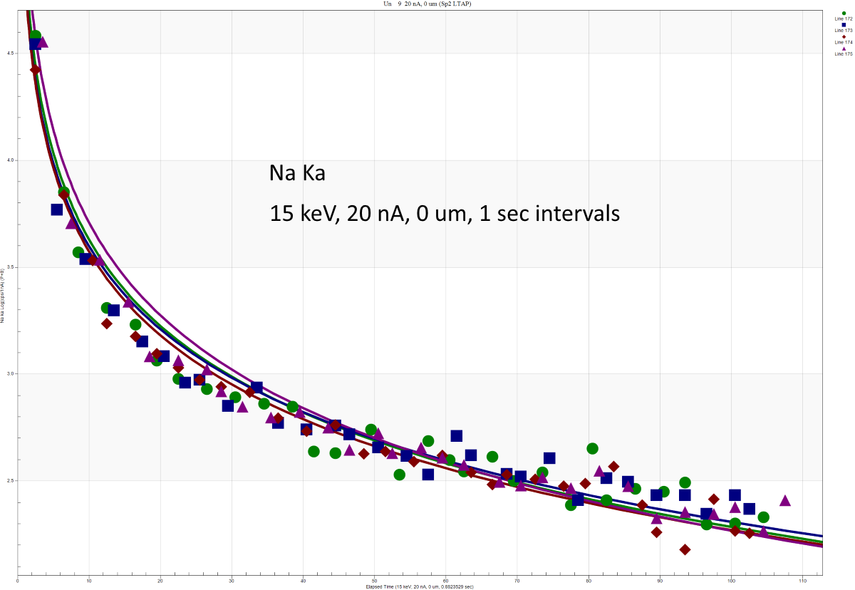
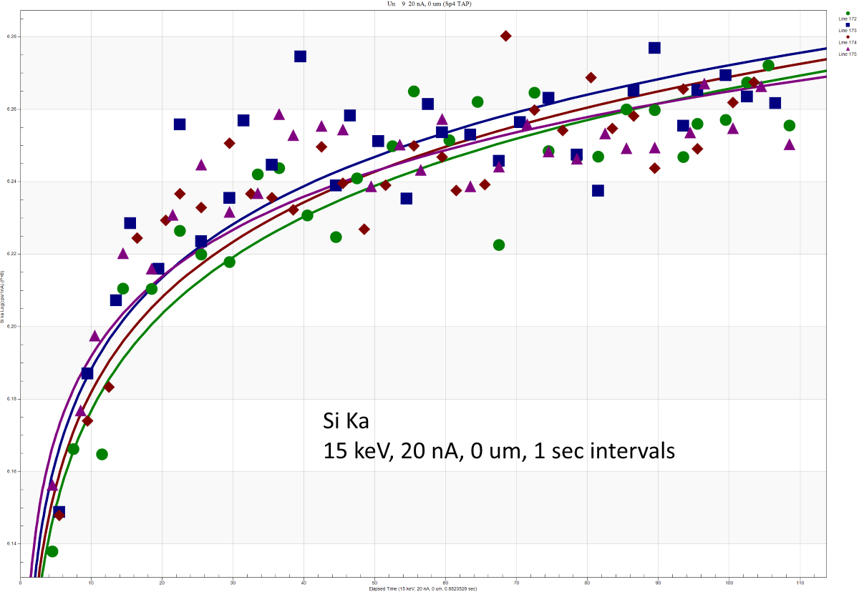
Sample/standard Error: Beam Sensitivity, cont’d
Y axis: Log Scale
SRM K-1718 20 nA, 0 um, 1 sec intervals, Si Ka
SRM K-1718 20 nA, 0 um, 1 sec intervals, Na Ka

Slide 15
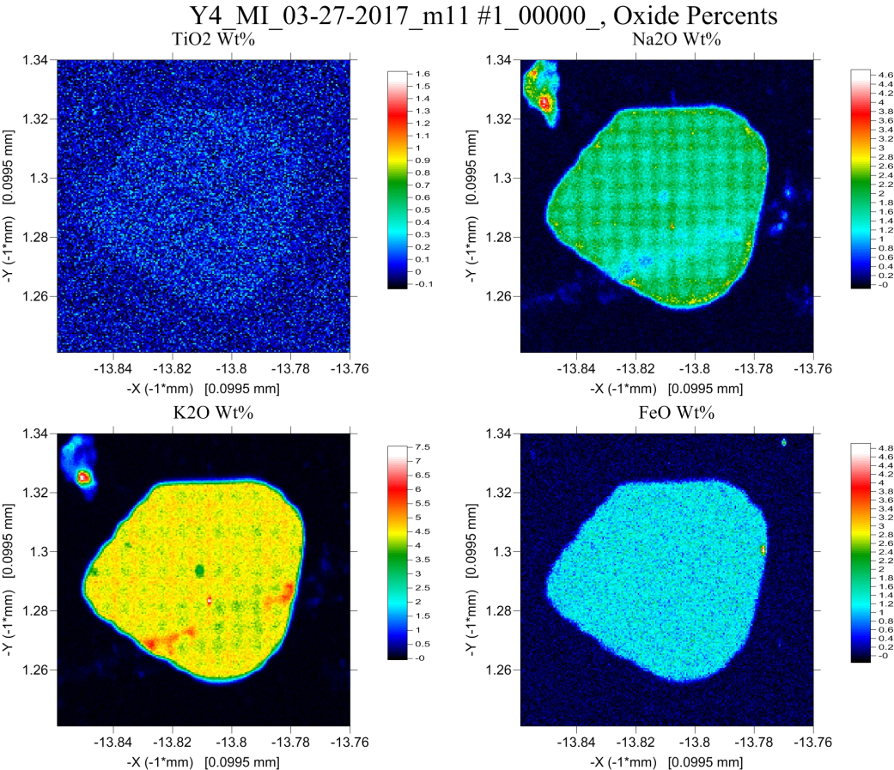
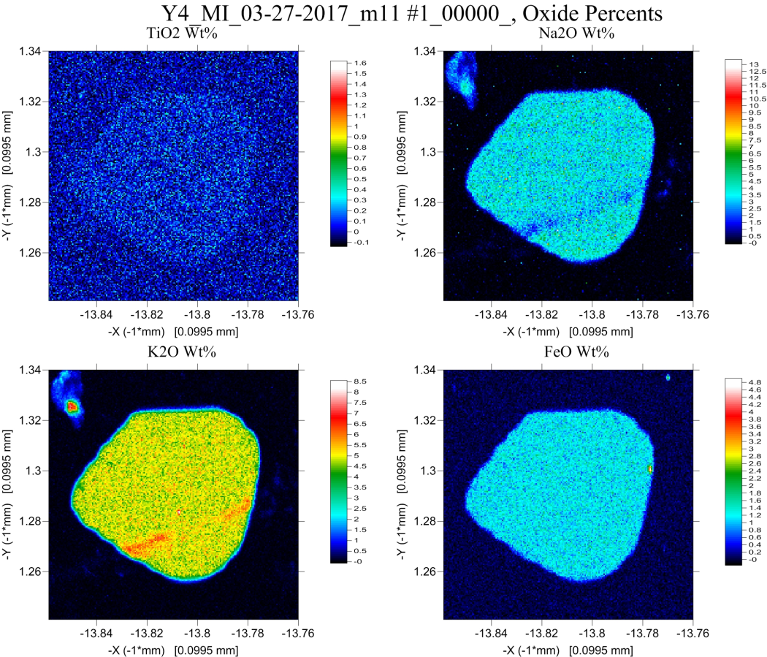
Time Dependent Intensity (TDI ) Corrections in Quantitative X-ray mapping
Without TDI correction
With TDI correction

